Slide 1
Catchy
Desktop Log Viewer for Embedded and Android Debugging
Project: Catchy (Log Analysis & Real-Time Monitoring Ecosystem)
Presenter: Nguyen Van Hoang (hoang5.nguyen)
Program: SW Expert Task

Slide 2
Executive Summary: Quantitative & Qualitative business achievements
• Performance: Slashed 500MB log loading times from 45s to 12s (~3.7x faster than legacy systems).
• Integration: Unified log analysis, bookmarking, and Scrcpy workflows to eliminate tool friction.
• Efficiency: Automated triage via smart filters, keyboard shortcuts, and split-view readability.
• Operations: Optimized Android/embedded QA productivity with auto-detection and live stream retention.
• Strategic Value: Delivered superior traceability and faster release validation by reducing context switching.

Slide 3
Catchy
Desktop Log Viewer for Embedded and Android Debugging
• The Platform: Combines comprehensive log analysis and real-time logcat monitoring in one unified interface.
• The Architecture: Purpose-built for large-scale data handling, advanced multi-file filtering, and workflow automation.
• The Value: Drives rapid debugging, flawless traceability, and superior usability over traditional inspection methods.
Catchy
Log viewer
Live stream
Search
Bookmark
Screen Copy

Slide 4
Problem Statement: Current Workflow Bottlenecks
Limitations of the Existing Tool
• Scalability: Latency issues when handling large-scale log datasets.
• Efficiency: Insufficient search and filtering mechanics for fast-paced triaging.
• Friction: Constant context switching between log data and real-time device activity.
• Visibility: Poor traceability of key events during iterative debugging cycles.
• Rigidity: Lack of integrated support for live streaming investigation and structured analysis.
Bonnibel.exe
Limited workflow
Slower triage

Slide 5
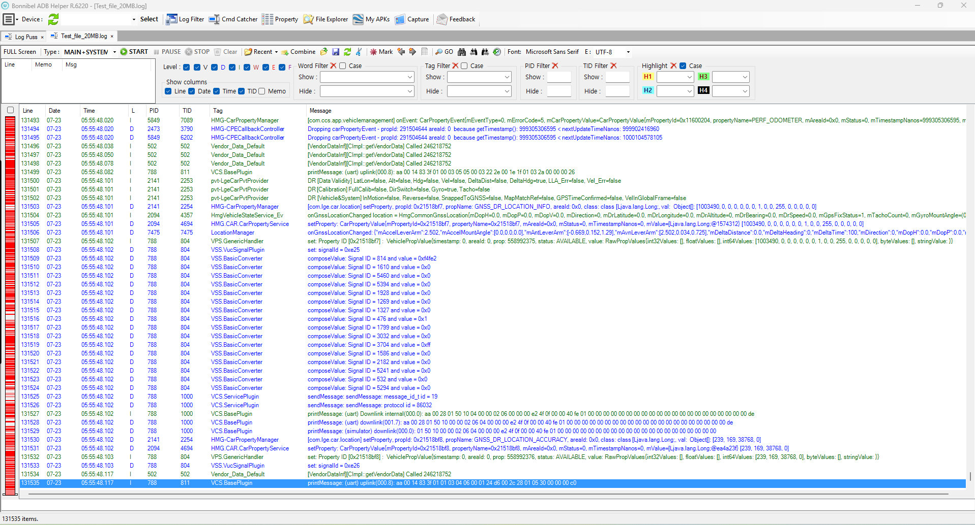
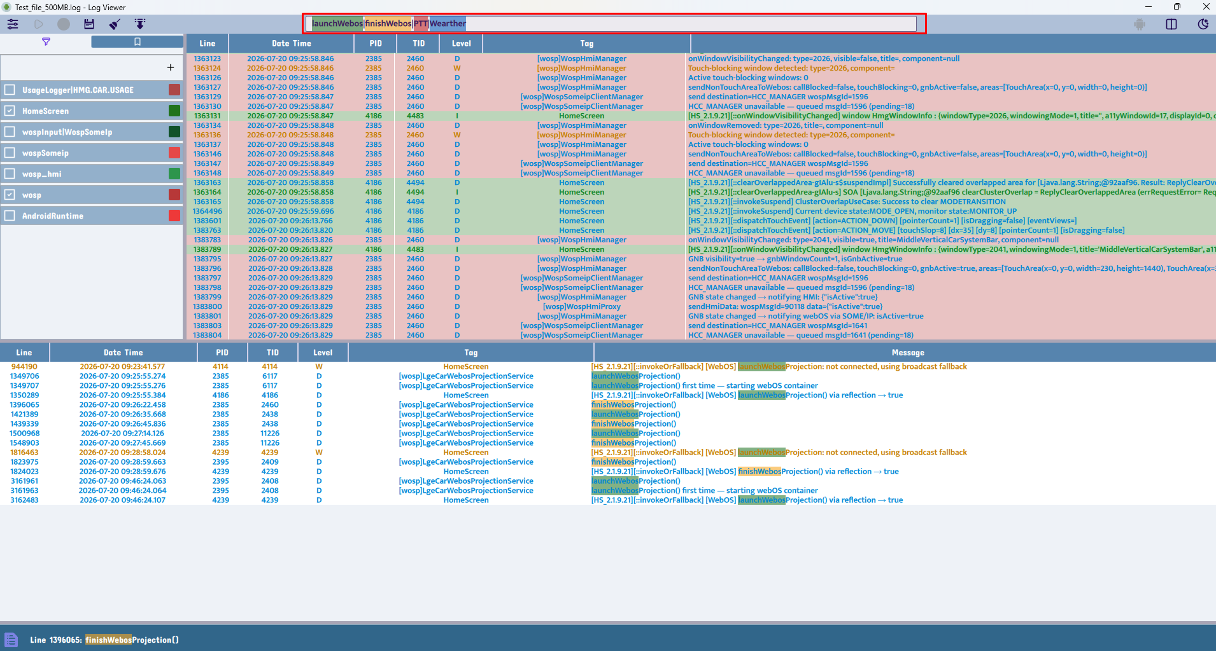
Comparative Evidence
Legacy Tool Versus Proposed System
The redesigned interface delivers an intuitive layout, minimized operational friction, and a highly optimized debugging workflow.

Slide 6
Performance Evaluation
Measured Loading-Time Comparison
File size | Catchy | Bonnibel.exe
20 MB | under 2s | under 2s
100 MB | 3s | 9s
250 MB | 6s | 20s
500 MB | 12s | 45s / occasional UI freeze
• Catchy: Sustained, lag-free responsiveness and smooth scrolling even when handling massive log datasets.
• Legacy Tooling: Noticeable bottlenecks, application freezes, and severe processing delays under identical data loads.

Slide 7
Evidence of Improvement
Major Bottleneck Reduction and Enhanced Usability
• File Ingestion: Slashed 500MB log load times from 45s (Bonnibel) to 12s (Catchy) with zero interface freezes.
• Live Monitoring: Adaptive UI prevents lag or performance degradation during intensive live logcat streaming.
• Device Handling: Automatic ADB state detection streamlines connections and boosts operational stability.
• Developer Workflow: Smart automation and keyboard shortcuts dramatically cut manual triaging efforts.
• Data Retention: Sustains a rolling 500MB data buffer while preserving smooth layout scrolling.

Slide 8
System Architecture
QML UI
Controller
Log Model
Filters
Search
Bookmark
• High-Throughput Concurrency: Utilizes an MVVM-inspired architecture backed by dedicated background worker threads to decouple massive file loading and live streaming ingestion from the main thread.
• Separation of Concerns: A centralized controller orchestrates core business logic, while a optimized QML presentation layer guarantees fluid UI rendering and low-latency user interactions.

Slide 9
Performance Tuning & Resource Management
📥 Smooth File Handling (Loading & Saving)
• Smart Data Batches (50,000 rows / load): Processes log files in fast, metered blocks.
• Benefit: Zero UI Freezing. The app stays fully responsive while loading massive datasets.
• Controlled File Exports (10,000 rows / write): Saves files in stable, bite-sized fragments.
• Benefit: Crash Prevention. Eliminates sudden computer memory spikes when saving data.
• Optimized Hardware Buffer (64 KB I/O): Matches the optimal hardware transfer speed of modern storage drives.
• Benefit: Maximum Speed. Achieves the fastest possible file read and write times.
🔀 Continuous Live Streaming (Logcat Retention)
• Automated File Splitting (50 MB limit): Instantly cuts ongoing live streams into separate, lightweight 50MB files.
• Benefit: Lightweight Data. Keeps file sizes small so searching and filtering remain lightning-fast.
• Strict History Safety Cap (500 MB / 10 files max): Retains only the 10 most recent files. It seamlessly recycles the oldest file when file number 11 arrives.
• Benefit: Infinite Live Monitoring. Engineers can leave the live stream running for days without ever overloading the computer's memory.

Slide 10
Core Functional Features
• Scalable Log Processing: High-performance background worker threads handle massive files asynchronously, complete with real-time visual progress indicators.
• Dynamic Logcat Ingestion: Live streaming data pipelines paired with smart auto-scrolling and instantaneous refreshes.
• Precision Analysis: Multi-keyword highlighting driven by a vibrant, color-coded pattern matching system.
• Targeted Debugging: Custom named filters optimized for targeted process-level and tag-based diagnostics.
• Context Preservation: Built-in bookmarking system to flag, save, and instantly revisit critical log events.
• Embedded Control Integration: Native Scrcpy synchronization enabling real-time, device-side visual verification and manual validation.

Slide 11
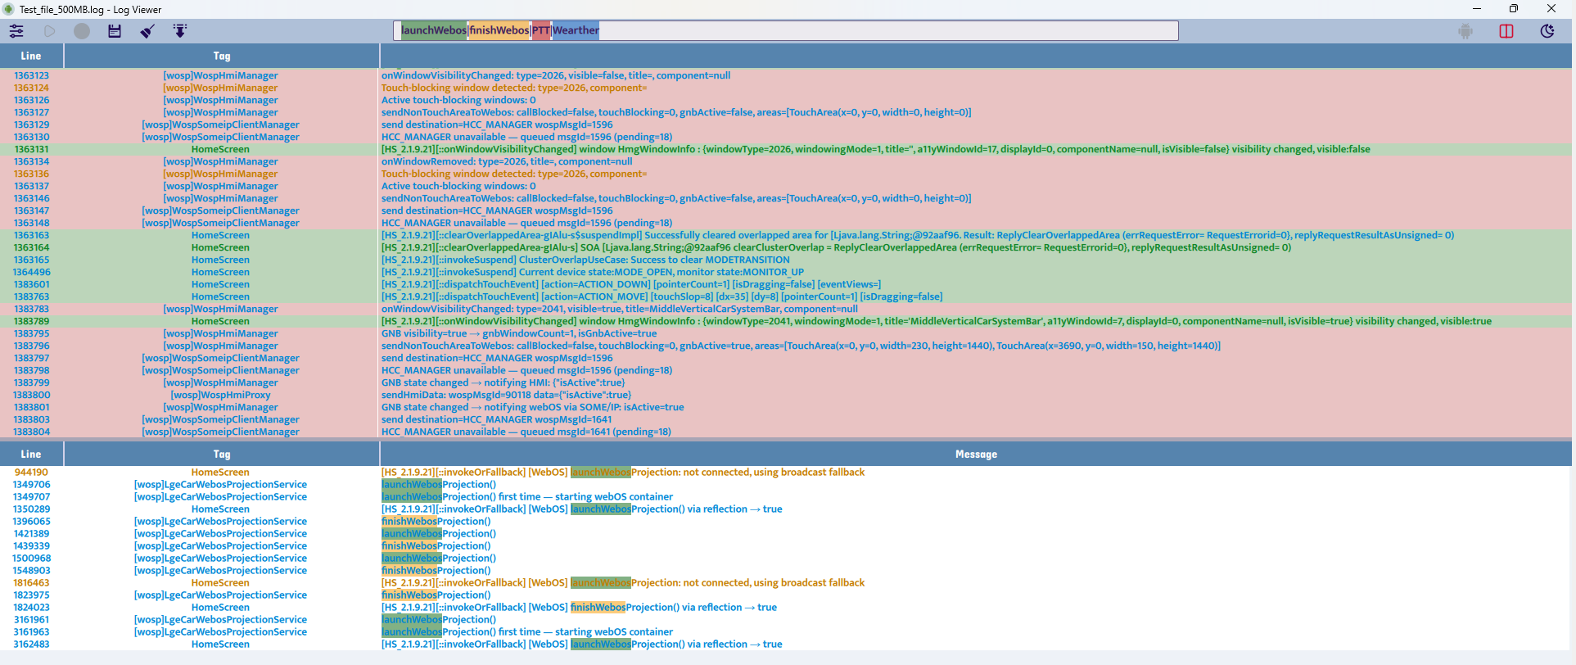
Full Log Viewer UI
Main view with log table and filtering controls
The full log viewer delivers an intuitive, structured interface optimized for massive datasets—significantly outperforming text-heavy legacy alternatives in analysis speed.

Slide 12
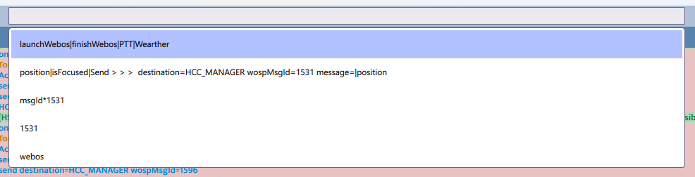
Long Search Box
Quick keyword search and result navigation
• High-Velocity Keyword Search: A dedicated search bar delivers instant querying, enhanced visibility, and rapid navigation directly to relevant log entries.
• Intelligent History Hints: Displays search history suggestions inline as you type, accessible instantly via a standard Ctrl + Space shortcut.

Slide 13
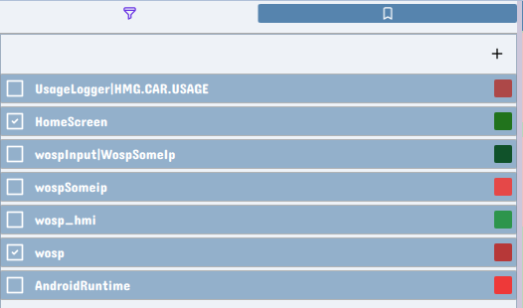
Tag Filter Panel
Color-coded tag and process filtering
• Noise Reduction & Signal Isolation: Combines customizable named filters with intuitive
color-coding to instantly isolate critical processes and strip out background noise from massive log datasets.

Slide 14

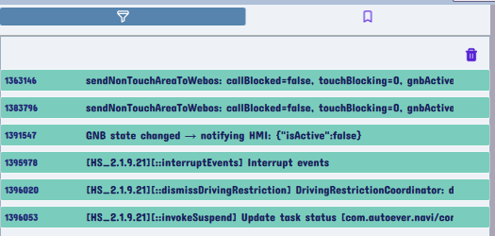
Tag Filter and Bookmark Panel
Filter management and bookmark workflow
• Intuitive Line Bookmarking: Click to select any log line, then right-click to instantly access the bookmarking and management menu.
• Unified Workspace (Left-Side Panel): Monitor active filters and bookmarked milestones seamlessly without leaving the main debugging view.
• Instant Context Jump: Click any bookmark link to leap directly to the targeted line and immediately analyze the surrounding code context.

Slide 15
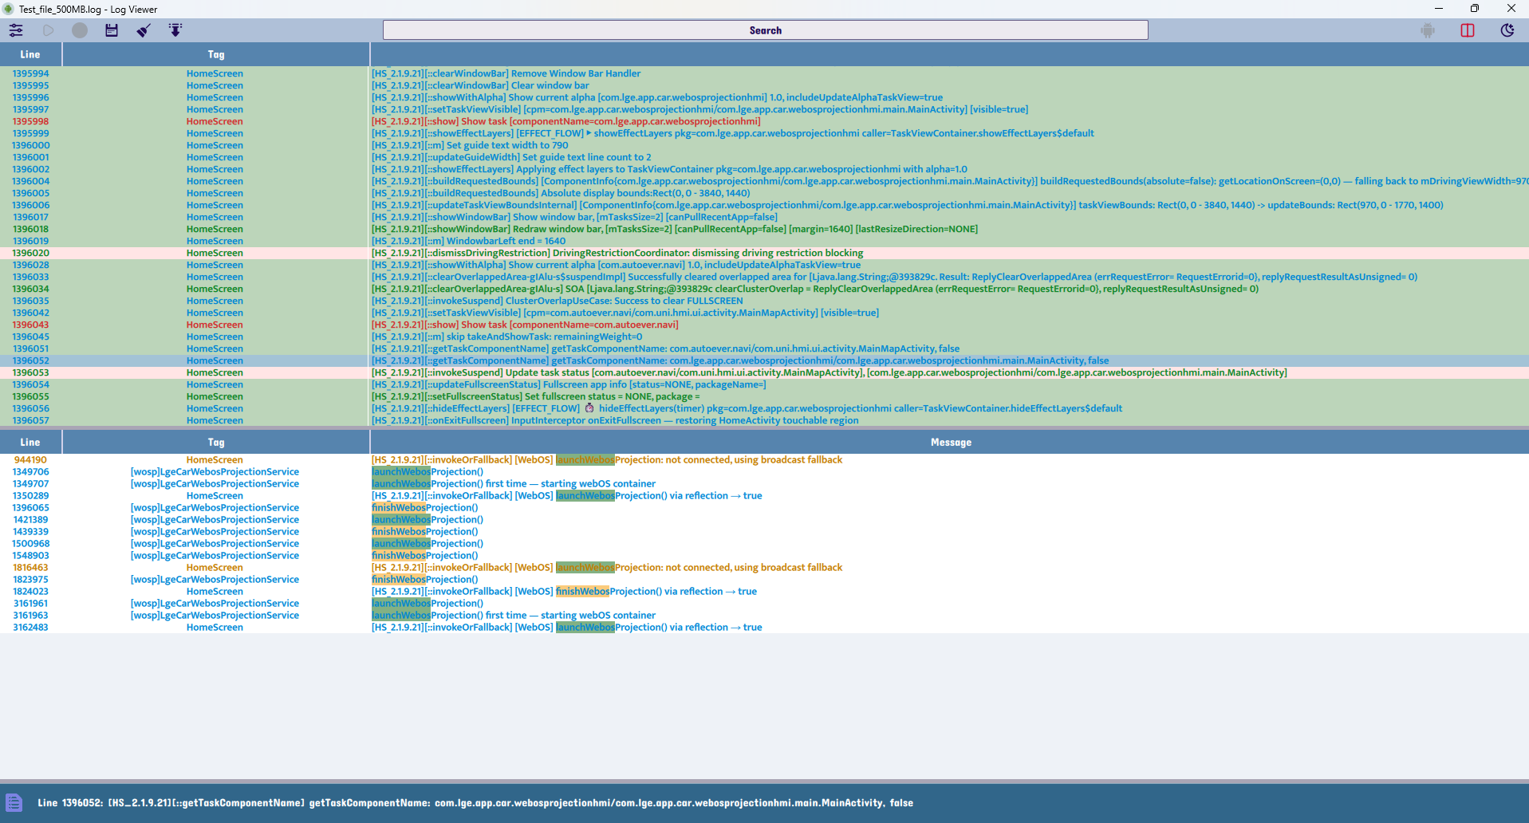
Split View for Long Content
Readable handling of expanded log content
• Optimized Split Layout: The intuitive split view preserves the readability of extended line content, eliminating the cramped, chaotic layouts that stall legacy debugging.
• Hierarchical Two-Layer Search: Employs an advanced stacked query mechanism—first isolating datasets by process/tag, and then executing secondary deep keyword searches within those refined subsets.

Slide 16
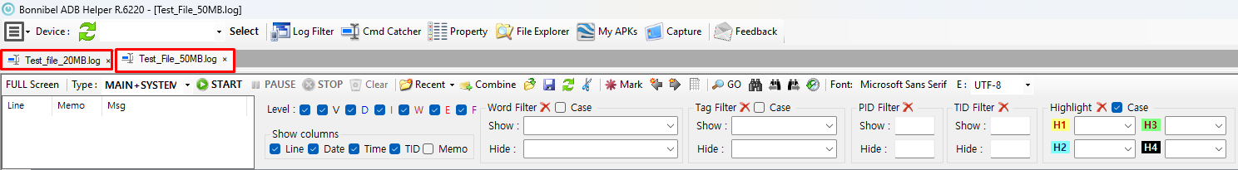
Challenge: Analyzing Disjointed Multi-File Logs
Alternative 1: Multi-Tab Browsing
Time-consuming and mentally fatiguing; forces engineers to manually track and correlate timelines across isolated tabs
Alternative 2: Pre-Merge Scripting (.bat, .py)
Requires writing, maintaining, and executing external scripts to manually stitch files together before analysis can even begin.
The Catchy Solution: Native Multi-File Merging
Instantly append or drop multiple log files directly into the active workspace. Catchy aggregates them into a single unified timeline within a single tab, eliminating manual preprocessing.

Slide 17
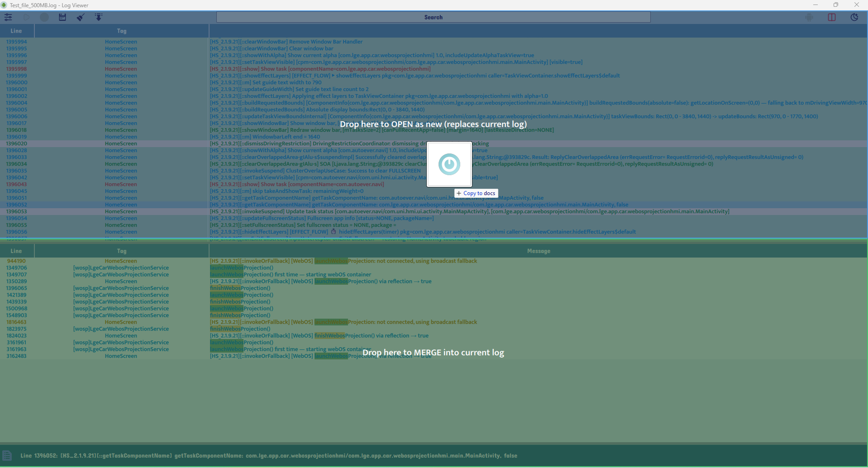
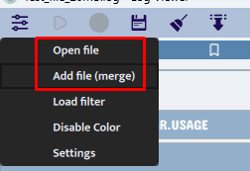
Dynamic Loading: Open vs. Merge Workflows
Open New Log Session
• Action: Drag file onto the top half of the screen.
• Result: Flushes active memory and spins up an isolated, clean log workspace.
Append & Merge Pipeline
• Action: Drop file directly into the active viewer.
• Result: Concurrently streams new data into the current buffer inside the same unified tab.

Slide 18
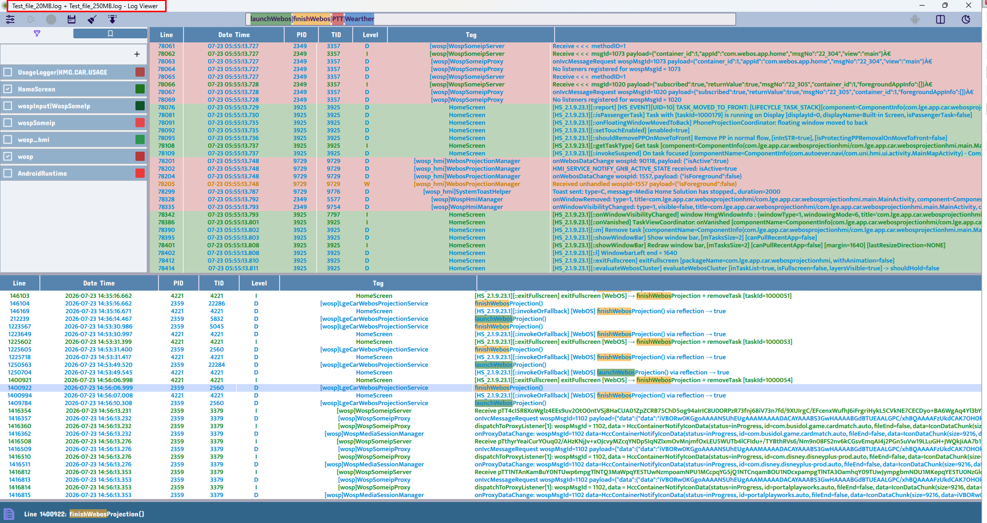
The Merged Interface Experience
• Single-File View Simplicity: Eradicates the chaos of multi-window setups by rendering all aggregated log entries into one continuous, readable stream.
• Composite Naming Convention: Automatically generates a brand-new file name string by stitching together the original file names for easy tracking.

Slide 19
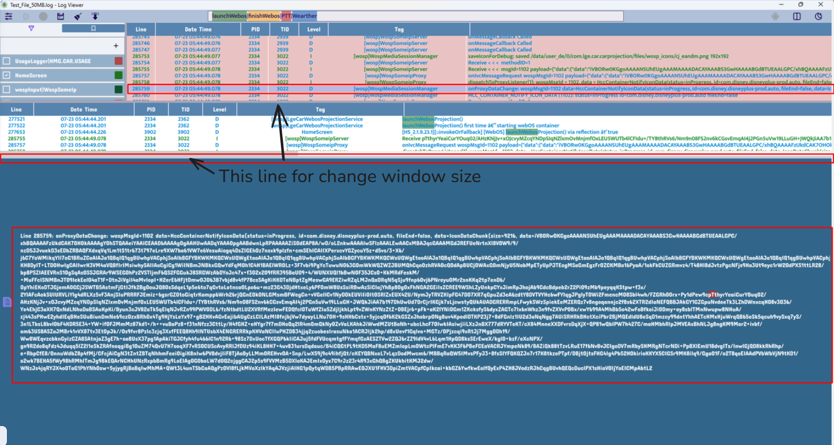
Maximizing Readability for Complex Log Lines
• Maximum Screen Utilization: Dedicated layout toggle allows an individual long log line to span the entire display.
• Frictionless Text Inspection: Eradicates visual clutter and horizontal scrolling bottlenecks during intensive diagnostic reviews.

Slide 20
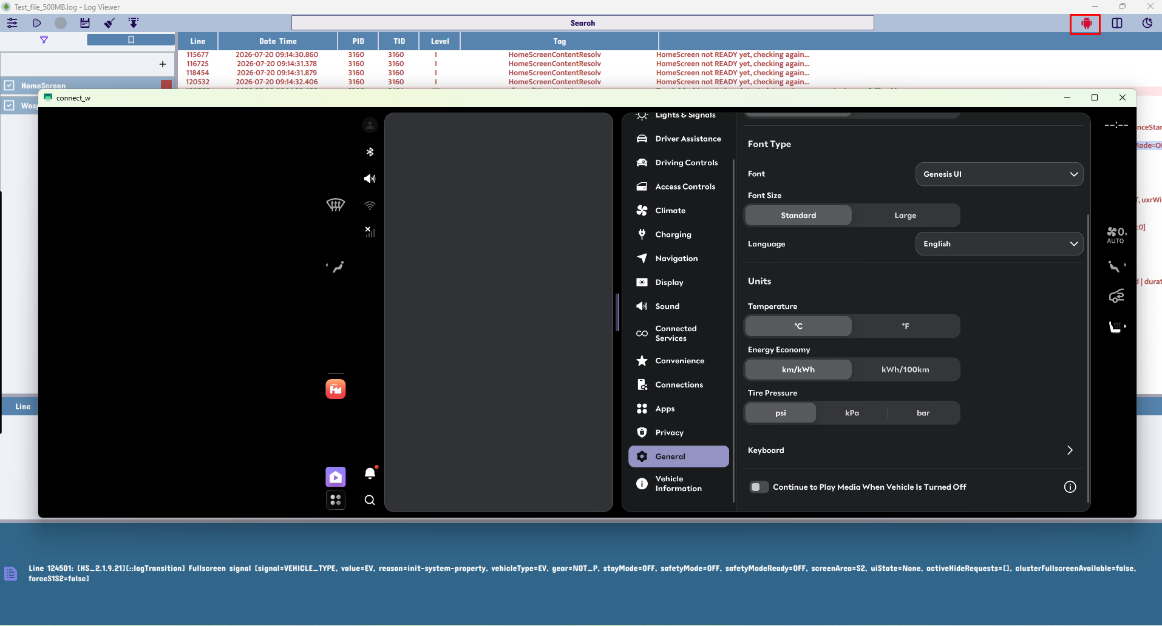
Auto-enable Scrcpy
Smart device integration
• Zero-Touch Scrcpy Initialization: The moment an Android target is connected via ADB, the application dynamically launches the integrated screen-mirroring workflow.
• Frictionless Real-Time Debugging: Eliminates manual tool launching and command-line setup, creating a completely fluid, concurrent log-and-display inspection environment.

Slide 21
Testing & Validation
Validation area | Result
Large log loading | Responsive while reading and parsing huge files
Live stream | Stable updates and auto-scroll control
Filters | Fast matching and color grouping
Search | Highlight multiple keywords correctly
Bookmarks | Quick jump and persistence
UI behavior | Dark/light theme and table responsiveness
ADB device handling | Auto enable/disable based on connection state

Slide 22
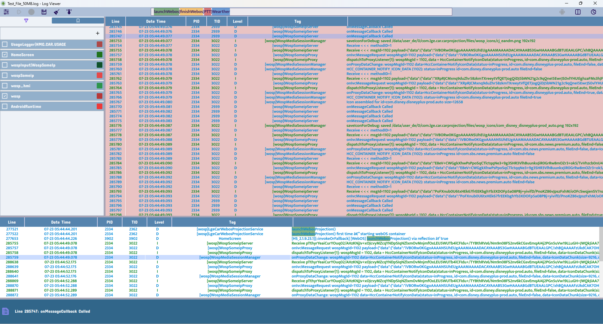
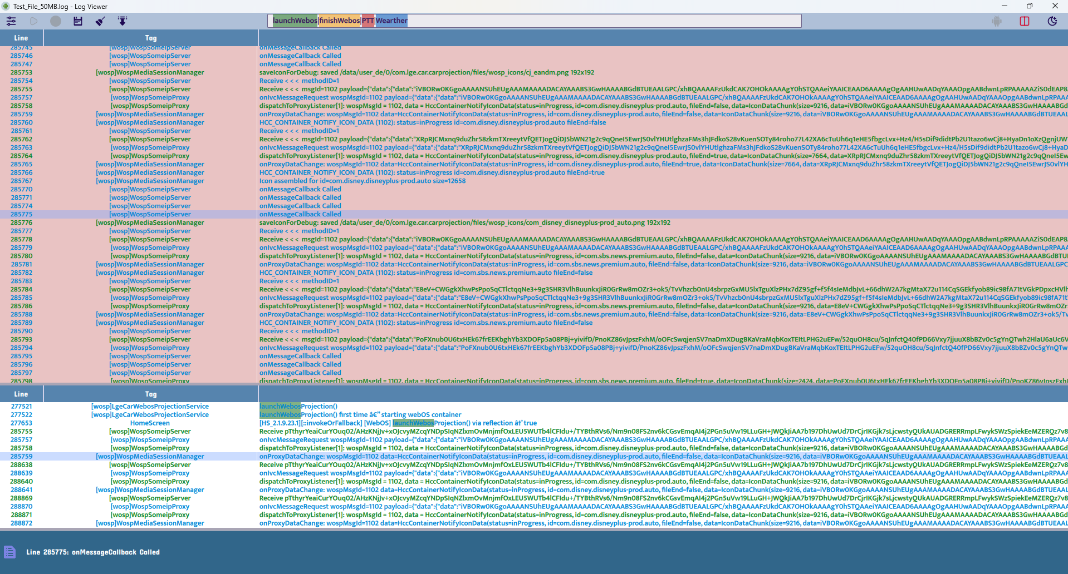
Proof of the New UI and Features
Easy-to-use workflow and improved capability
By pairing a clean interface design with a robust, automated feature set, the platform eliminates operational friction and maximizes overall triaging efficiency.

Slide 23
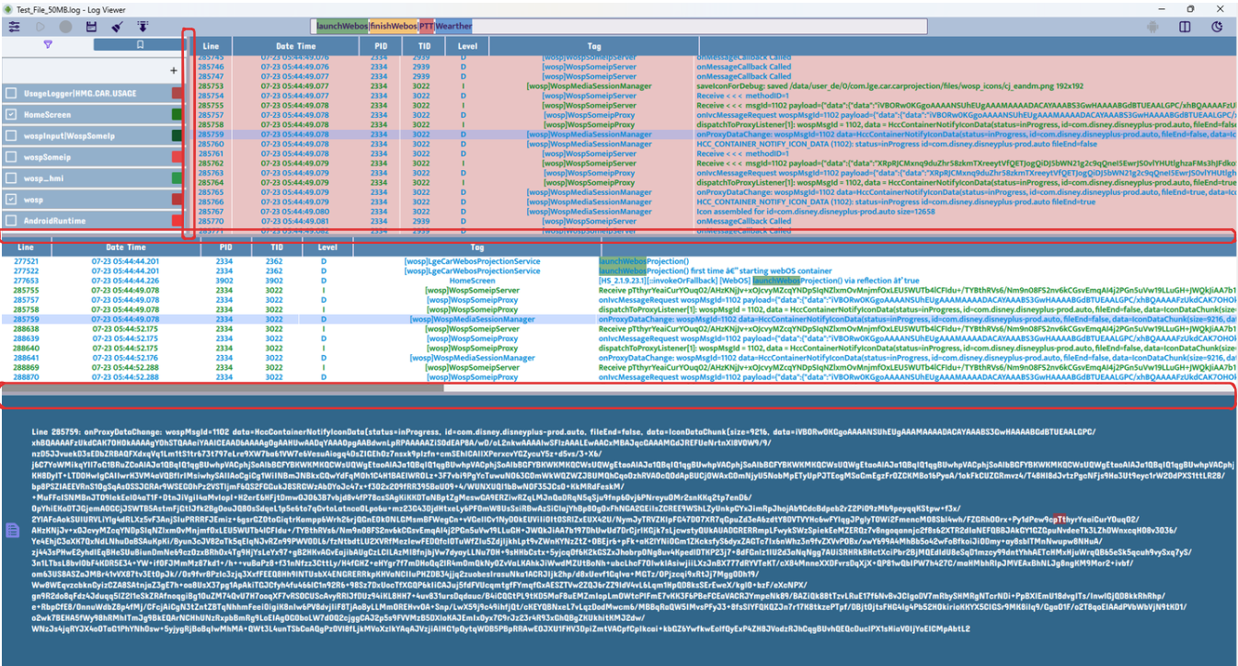
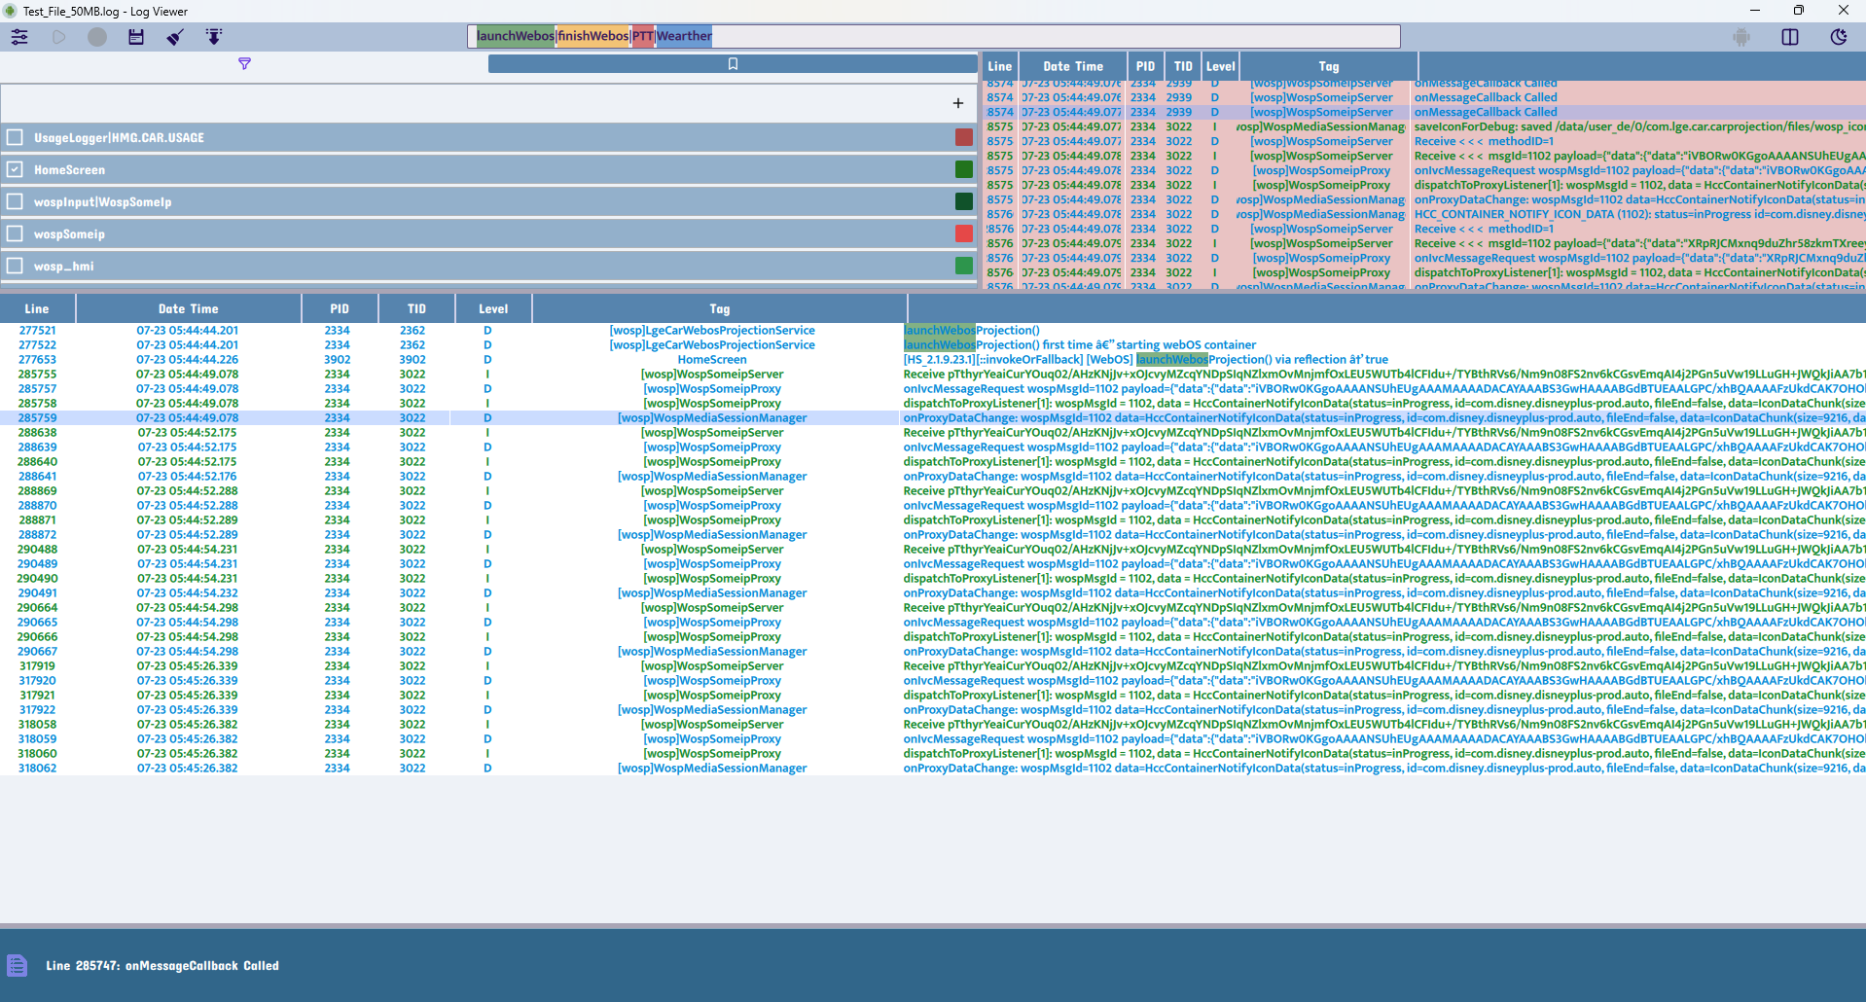
Proof of the New UI and Features
Easy-to-use workflow and improved capability
Dynamic Workspace Customization: Empower engineers to seamlessly tailor interface layouts to match the specific demands of diverse debugging use cases.

Slide 24
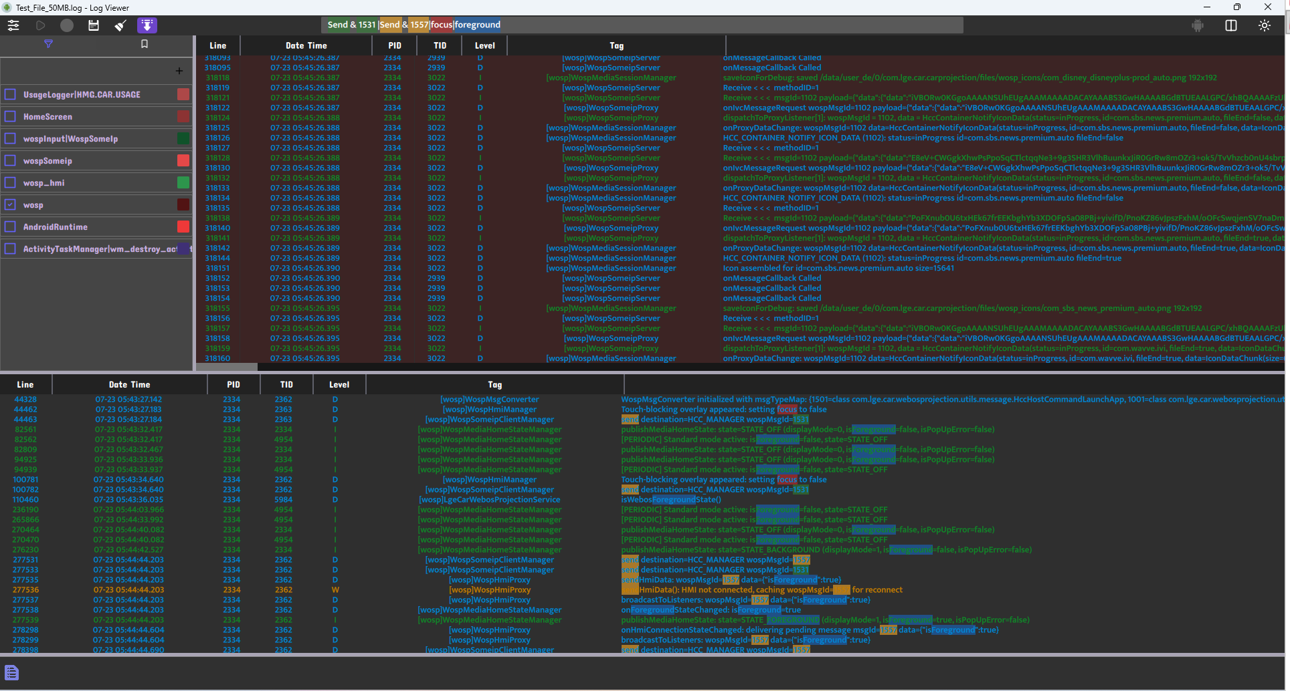
Proof of the New UI and Features
Easy-to-use workflow and improved capability
Native Dark Theme Support: Features a fully optimized dark mode designed to minimize eye strain and enhance visual comfort during extended night testing or deep-dive triage sessions.

Slide 25
Keboard Shortcuts
Project Outcome and Value Delivered
ShortCut | Action
Ctrl + F | Seach
Ctrl + B | Column management
Ctrl + T | Edit the newest filter
Ctrl + Shift + T | Add the new filter
Ctrl + M | Toggle bookmark panel
Ctrl + P | Toggle auto-scroll
Ctrl + Space | Show search history words

Slide 26
Conclusion
Project Outcome and Value Delivered
• Automated Device Onboarding: Drastically reduces setup friction by instantly triggering log streaming and screen-copy workflows upon ADB detection.
• Proactive State Guardrails: System-wide action adaptation prevents configuration mistakes by dynamically managing feature states based on hardware availability.
• Ergonomic Workspace Architecture: Replaces clunky, multi-tool setups with smooth scrolling canvas profiles, drag-to-merge layouts, and clear side-panel diagnostics.
• Uncompromised Data Continuity: Guarantees comprehensive trace preservation during prolonged testing cycles using a high-capacity, lag-free 500MB buffer window.

Slide 27
Thank you for your time and
your technical evaluation.

